Slide 1
CUSTOMER RELATIONSHIP MANAGEMENT
CONCEPTS AND TECHNOLOGIES
Chapter 11
Managing supplier and partner relationships

Slide 2
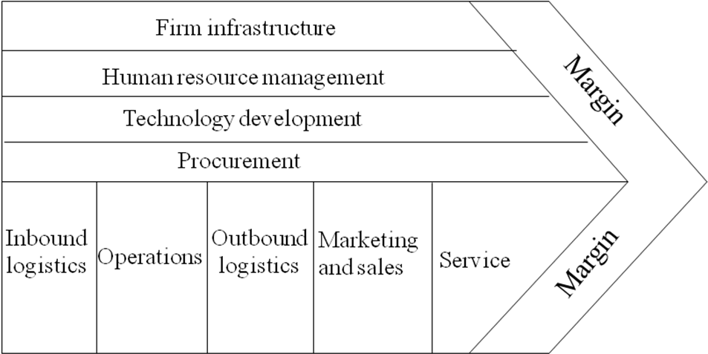
The value chain

Slide 3
Why supplier relationships are important
Suppliers should be aligned and synchronised to contribute significantly to the achievement of value for both the focal company and its customers.
At the very least, suppliers need to be briefed and managed so that they provide the right inputs, at the right time and at the right price to enable the focal company to serve its customers well.

Slide 4
Costs of inputs goods and services
In 2006, General Motors spent US$164 billion and General Electric spent US$74 billion on purchasing input goods and services.
In 2006, Toyota spent ¥16,335 billion on input goods and services.
  A 1% saving in procurement costs would lead to a direct improvement in Toyota’s bottom line over ¥163 billion,
For many companies, purchasing costs are 50% or more of the total costs of running the business.
  In electricity and gas utilities input goods and services are 10% to 15% of sales; in electronics it is 30% to 60%; in chemicals it is 40% to 85%.

Slide 5
Forms of co-operation with suppliers
Product development
Supplier accreditation
Process alignment

Slide 6
Supplier accreditation options
Requiring suppliers to be certified as ISO 9000 compliant
Requiring suppliers to monitor and improve their operations against an external business excellence standard
Developing and implementing your own accreditation program.

Slide 7
ISO 9000 definition of quality
The ISO 9000 series is an international quality standard in which quality is defined as ‘the totality of features and characteristics of a product or service that bear on its ability to satisfy stated or implied needs.’

Slide 8
The ISO 9000 family
ISO 9000
  describes the fundamentals of quality management systems; sets out the terminology of quality management systems.
ISO 9001
  specifies the requirements of a quality management system
ISO 9004
  provides guidelines for both the effectiveness and efficiency of quality management systems.
ISO 19011
  provides guidance on auditing quality management systems.

Slide 9
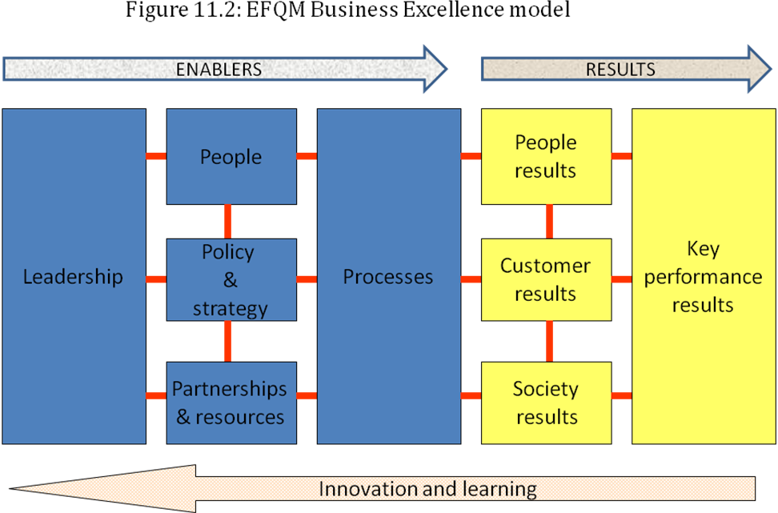
EFQM excellence model

Slide 10
Process alignment
Quality management processes
Order-fulfilment process

Slide 11
Aligning quality management processes
  The customer establishes best-in-class quality standards
  The supplier benchmarks quality conformance against best-in-class and identifies opportunities for improvement
  Supplier and customer agree strategy for quality improvement, involving kaizen (continuous improvement by all people involved in the process), information sharing, and on-going benchmarking
  Supplier introduces a quality assurance program (quality inspection program abandoned by customer!)

Slide 12
How NCR’s purchasing policies changed
Then
Now
Contract renegotiated annually
Incoming inspection
Purchasing components
Over 2000 suppliers
Unreliable parts quality
Evergreen contracts
Benchmarking
Securing technology
150 suppliers
50 to 100 non-compliance per million incoming parts

Slide 13
Technologies for aligning the order-fulfilment process
EDI
Portals

Slide 14
Electronic Data Interchange (EDI)
EDI enables suppliers and customers to trade electronically.
EDI involves the interchange of unambiguously structured inventory, order and invoice data between computers according to agreed message standards.
EDI eliminates the labour-intensive paper trail that is characteristic of many order-processing systems.
Large manufacturers, such as automobile companies, require their suppliers to implement EDI.

Slide 15
Strategic benefits from EDI
EDI acts as a structural bond that not only symbolises the commitment of the participants, but also acts as barrier to exiting the relationship.
EDI provides convenient access to accurate customer purchasing and payment histories, and detailed customer management costs that can be useful when conducting customer portfolio analysis
EDI ensures improved customer service (more accurate and timely fulfilment)
EDI records allow suppliers to produce more accurate demand forecasts
EDI creates the possibility to developing new business processes such as Just-in-Time operations.

Slide 16
Operational benefits from EDI
EDI eliminates the need to re-enter data from paper documents, thus preventing clerical errors.
Electronic processing of orders costs a fraction of paper-based systems, perhaps as little as one-tenth.
EDI systems can reduce inventory costs.
Use of EDI to transmit invoice data and payments can improve cash flow and working capital.

Slide 17
Portals
A portal is a company’s electronic shop window.
Extranets enable customers and other visitors to get access to parts of the ‘store’ behind the portal ‘store-front’ from outside the company.
Visitors gain access by password or security certificate.
Customers can use a supplier’s portal to place orders, track order progress, download training manuals, obtain price lists, access FAQ pages, and obtain invoices, brochures and collateral materials.

Slide 18
Trends in supplier relationship management
vendor reduction programs
category management
product development alliances
electronic procurement

Slide 19
Benefits from vendor reduction programs
Reduced transaction costs
Additional volume discounts
Performance compliance
Increased technical co-operation

Slide 20
Tesco benefits from vendor reduction programs
Tesco claims several advantages:
lower costs
improved investment climate
better product quality
improved logistics
better product development
… and one danger:
supplier complacency

Slide 21
Vendor reduction programs from around the world
British Home Stores(UK) - from 1,000 product suppliers to 80, of whom 35 supply 80% of BHS’s retail assortment
Shell Retail (UK) -from 50 product suppliers to 30
Laura Ashley (UK) -from 8 logistics vendors to 1
Xerox (USA) -from 5000 suppliers to 400 in 5 years
Compaq (USA) -from 35 logistics vendors to 5
Ford (USA) -from 3200 to 2100 in 6 years
SEAT (Spain) -from 1500 suppliers to 300 in 2 years
Woolworths (Australia) -from 2000 product suppliers to 300
Wattyl (Australia) -from 100 suppliers to 10

Slide 22
Category management definition
Category management is the management of a group of related or substitutable products as a single strategic business unit.

Slide 23
Retailer-supplier cooperation for category management
Category management requires the retailer and supplier to establish close links that enable them to agree category objectives, optimise the category assortment, introduce new products, de-list brands or items that do not contribute to category performance and plot category or brand promotions.
Category management is enabled by IT applications such as EDI, electronic funds transfer and activity-based costing.

Slide 24
Category management benefits
Benefits for supplier
Increased profitability
Increased business
knowledge
Improved relationships
with retailers
Benefits for retailer
Financial:
Increased sales
Increased margins
Reduced costs
Improved efficiency
Increased market share
Non-financial:
Organizational learning
More effective strategy implementation
Better customer service
Improved customer knowledge
Understanding cost structures
More open communications with suppliers
Improved personal relationships
Stability of best practice

Slide 25
Motivations for electronic procurement
For customers, online purchasing offers the prospect of reduced procurement costs and immediate order placement.
Suppliers, in turn, are motivated to sell direct to customers because it offers the prospect of three benefits:
  reduced customer management costs
  enhanced control over the customer experience,
  enhanced cash-flow due to immediate payment.

Slide 26
B2C e-commerce in the USA
In 2003, 70 million American households (62% of households) had one or more computers, up from 56% in 2001, and sixty-two million households (55% of households) had Internet access, up from 50% in 2001.
18% of adults conducted banking online in 2003.
12% of adults used the Internet to search for a job
47% of adults used the Internet to find information on products or services.
32% of adults purchased a product or service online

Slide 27
B2B e-commerce in the US
In 2005 business-to-business e-commerce (defined as transactions by manufacturers and merchant wholesalers) accounted for 92% of all e-commerce.
Evidence indicates that B2B e-commerce relies overwhelmingly on proprietary Electronic Data Interchange (EDI) systems.
Experts generally agree that the value of transactions in B2B e-commerce is about 10 times the value of B2C e-commerce.

Slide 28
Online B2B sales in the USA
In 2006, 27% of the total shipments by value of manufactured output was sold online.
The industries with the largest percentage of online sales were transport equipment manufacturing (53%) and beverage and tobacco manufacturing (49%).
Eighteen percent of merchant wholesaler trade sales were completed online in the same year.
The trend for both manufacturer and merchant wholesaler online sales is upward.

Slide 29
Taxonomy of online business models
e-shops
e-procurement
e-malls
e-auctions
third-party marketplaces.

Slide 30
Partners in the SCOPE model of CRM
Partners in value creation
  Joint venture or alliance partners
  Category teams
  Benchmarking partners
  Regulators
  Customer advocacy groups
  Sponsors
Partners in value delivery
  Agents
  Brokers
  Management contractors
  Consortia
  Franchisees
  Licensees

Slide 31
Alliances between non-competing firms
market expansion
vertical integration
diversification

Slide 32
Alliances between competing firms
shared supply alliances
quasi-concentration alliances
complementary alliances

Slide 33
Benchmarking definition
Benchmarking is a business improvement discipline involving the continuous, systematic evaluation of products, services, and processes against organizations that are recognized as representing best practice.

Slide 34
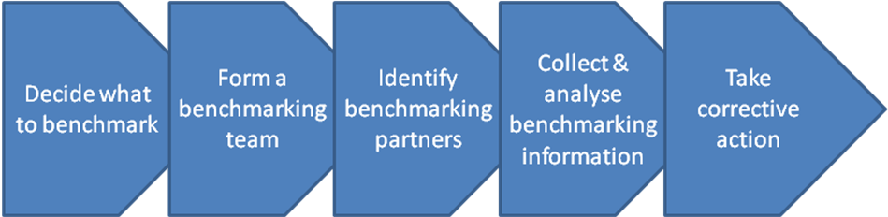
The benchmarking process

Slide 35
Forms of benchmarking group
internal to a company
intra-industry
  Telecoms: AT&T, Nynex, MCI and GTE
trans-industry
  Financial management: FedEx, Caterpillar, Westinghouse and DuPont

Slide 36
Regulators
Many industries are regulated, particularly those in which consumers are thought to be at risk either because of deregulation or because of monopolistic competition.
  financial services, telecoms, rail, gas, electricity and airlines.

Slide 37
Customer advocacy groups
CAGs promote and protect the interests of consumers.
  CAGs operate within many countries.
    Consumers’ Association of Canada
    Consumers’ Association of Singapore
    Consumers’ Association of Iceland
In the UK, the Consumers' Association founded in 1957, publishes Which?, researches and campaigns on behalf of consumers, and has 650,000 members.
  The CA’s mission is to ‘make individuals as powerful as the organisations they have to deal with in their daily lives.’

Slide 38
Patient advocacy groups
National Schizophrenia Fellowship (NSF)
Depression Alliance
SANE
Parkinson Disease Society
British Diabetic Association
National Osteoporosis Society
Amarant Trust
Terence Higgins Trust
Women Health Concern
Aids Treatment Project
Wellbeing
Macmillan Cancer Relief
British Heart Foundation

Slide 39
Sponsorship definition
Sponsorship is the material or financial support of some property, normally sports, arts or causes, with which an organisation is not normally associated in the course of its everyday business.

Slide 40
Benefits sought by sponsors
Increasing awareness and visibility for the product or company
Influencing consumer attitudes
Influencing consumer behaviour
Associating the product or company with a life-style
Entertaining key clients
Rewarding employees
Finding opportunities to launch new products
Differentiating the product or company from competitors

Slide 41
Partners in value delivery
Agents
Brokers
Management contractors
Consortia
Franchisees
Licensees

Slide 42
Agents
Commonly used when a business is small or geographically separated from the markets served and doesn’t want or cannot afford to recruit and operate its own sales team.
Do not purchase and resell; they simply represent the principals whose products they sell.
Are order-getters, offering business owners the opportunity to access their established networks.
Generally work on a commission basis.

Slide 43
Two types of manufacturer’s agent
A manufacturer’s agent represents one of more principals that produce non-competing lines.
  They provide an outsourced selling function.
  Generally they agree contractual terms covering lines sold, territorial rights, prices, commissions, order-processing routines and returns policy.
A selling agent is contracted to sell a manufacturer’s entire output.
  Very often these are found in primary and production-oriented businesses such as mining, forestry and industrial equipment.

Slide 44
Management contractors
Management contractors are companies that undertake to manage some important part of a business, even the customer interface, on behalf of a principal.
They are common in the hospitality industry where the ownership and operation of hotels are separated.
  It is not unusual for hotels to be owned by an insurance or investment company, and for the operation of the hotel to be contracted out to a hotel management company.

Slide 45
Consortia
A consortium is a group of organisations that act co-operatively for mutual benefit.
Often the organisations are independent of each other as in the Best Western and Flag Hotel consortia, and the members of the SPAR group of independent grocery retailers.
Consortia are generally not-for-profit organisations, built to generate economies of scale for their memberships.
There are economies to be found in purchasing, marketing, training and development, and operations.

Slide 46
Franchisees
Franchising is a rapidly growing form of business.
A franchise is a license to operate a business format for a prescribed time format within a defined geographic area.
Franchisees receive training in the operational and managerial processes for running the format successfully. They get access to a proven customer value proposition and a turn-key business operation.
Typically a franchise or investment fee is paid up front and as well as an on-going royalty on sales.

Slide 47
Licensees
Licenses are rights granted to a business partner to exploit intangible assets such as technology, skills, designs or knowledge in exchange for remuneration such as fees or royalties.
The value of licensing arrangements is estimated to exceed US$150 billion annually

